Slide 1
C&I Initiative

Slide 2
Who We Are

Slide 3
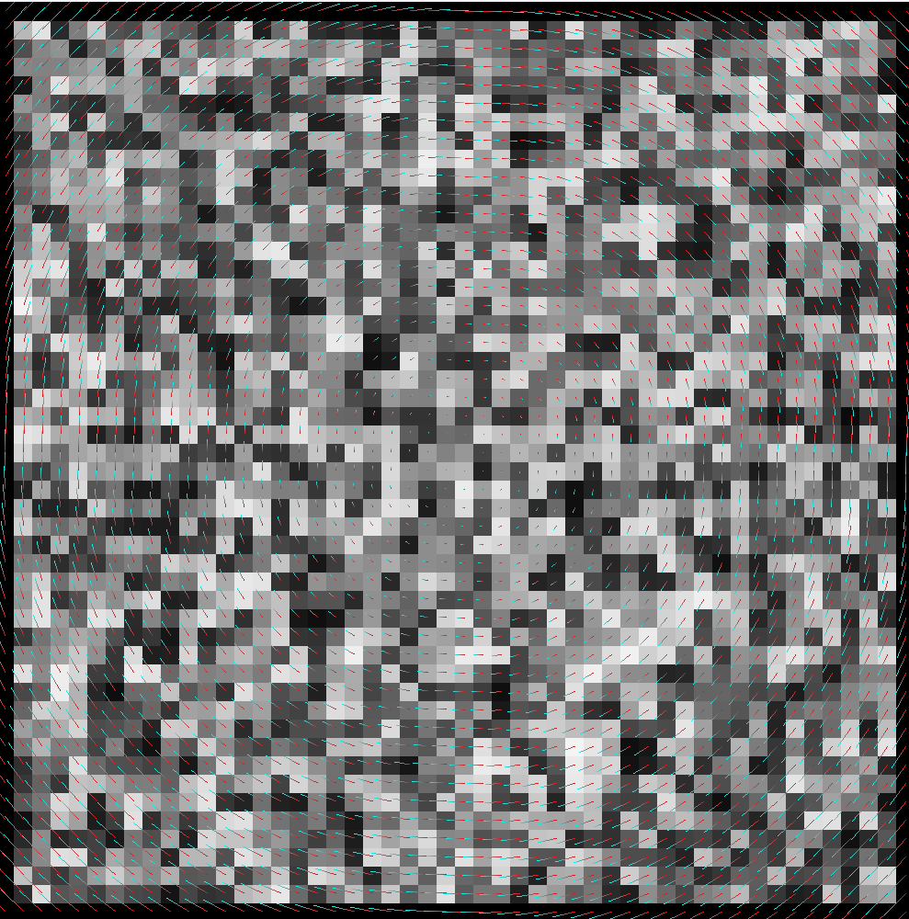
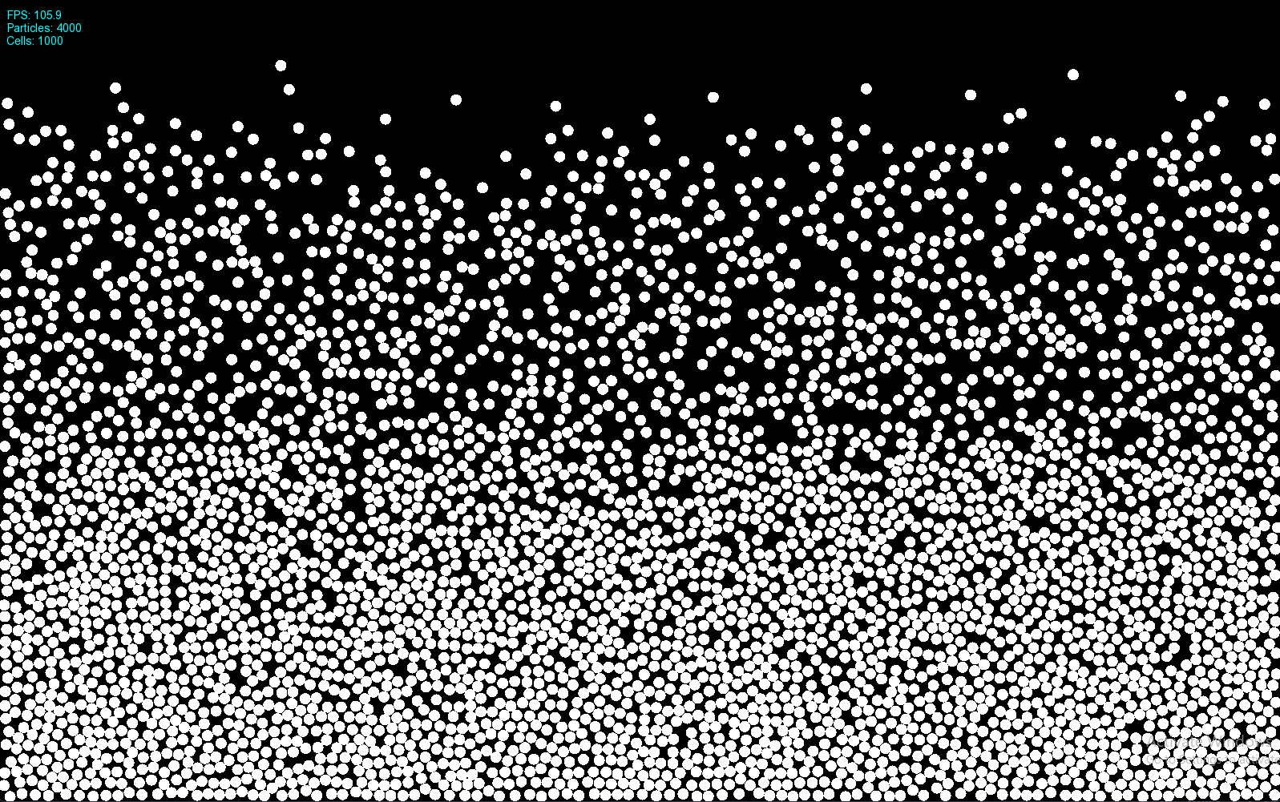
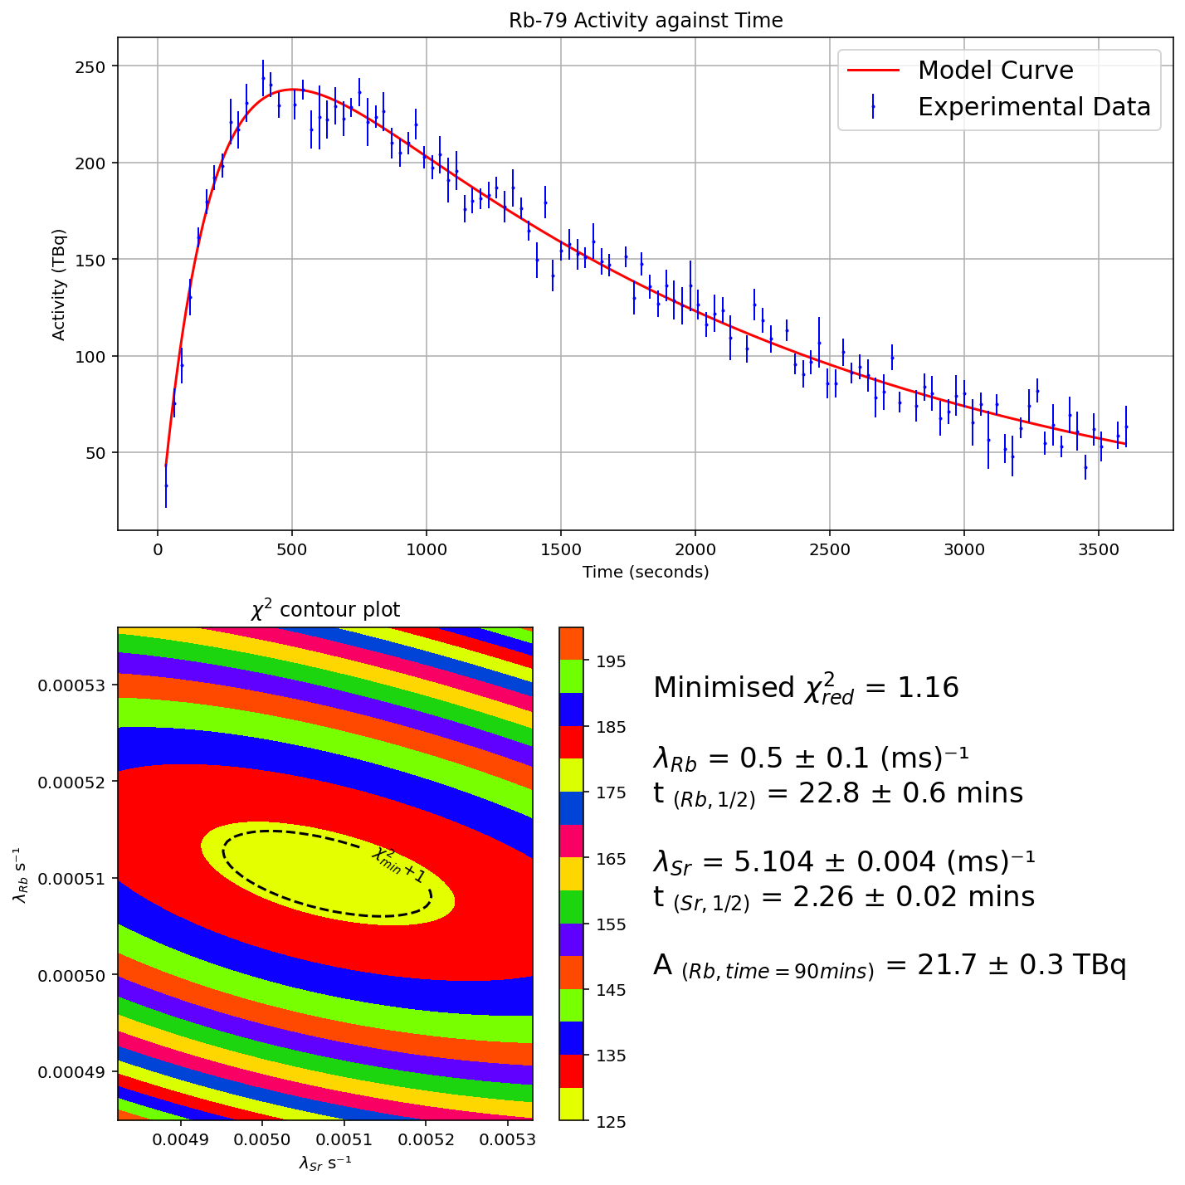
Colin Dickey BSc(Hons) Physics w/ Theoretical Physics
Interests
Fluid Physics and Computation
Data Analysis
Physics Engines
C++ and Python
https://colin-dickey.github.io/website/ (For a quick run through of some projects)

Slide 4
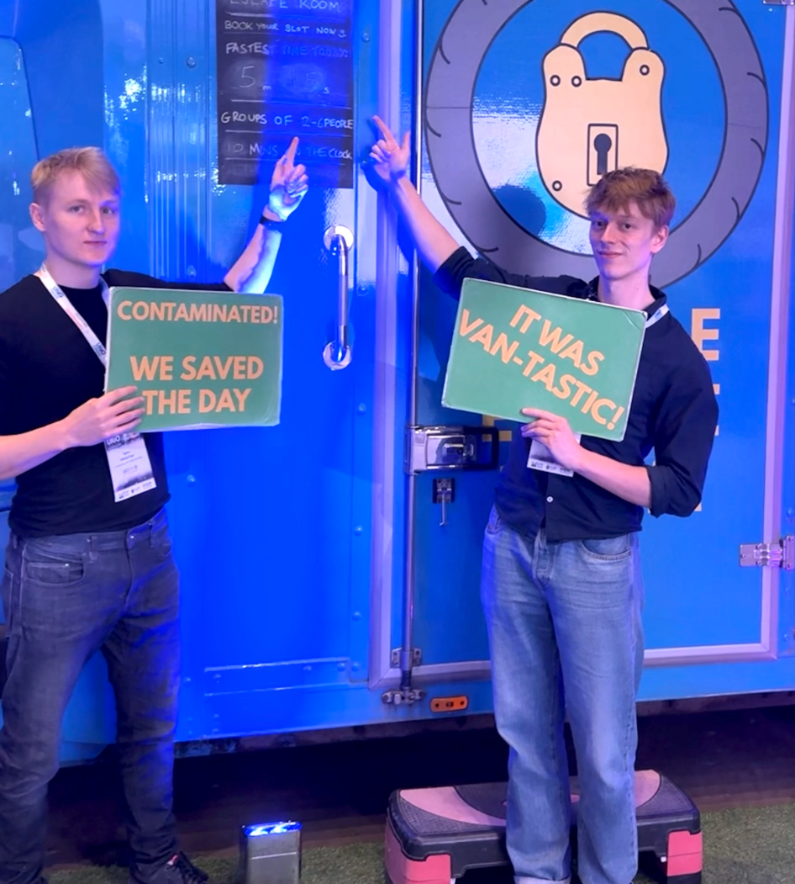
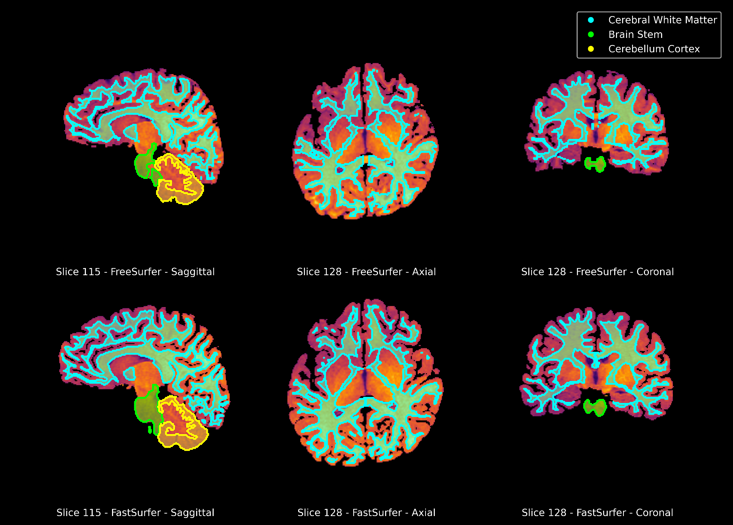
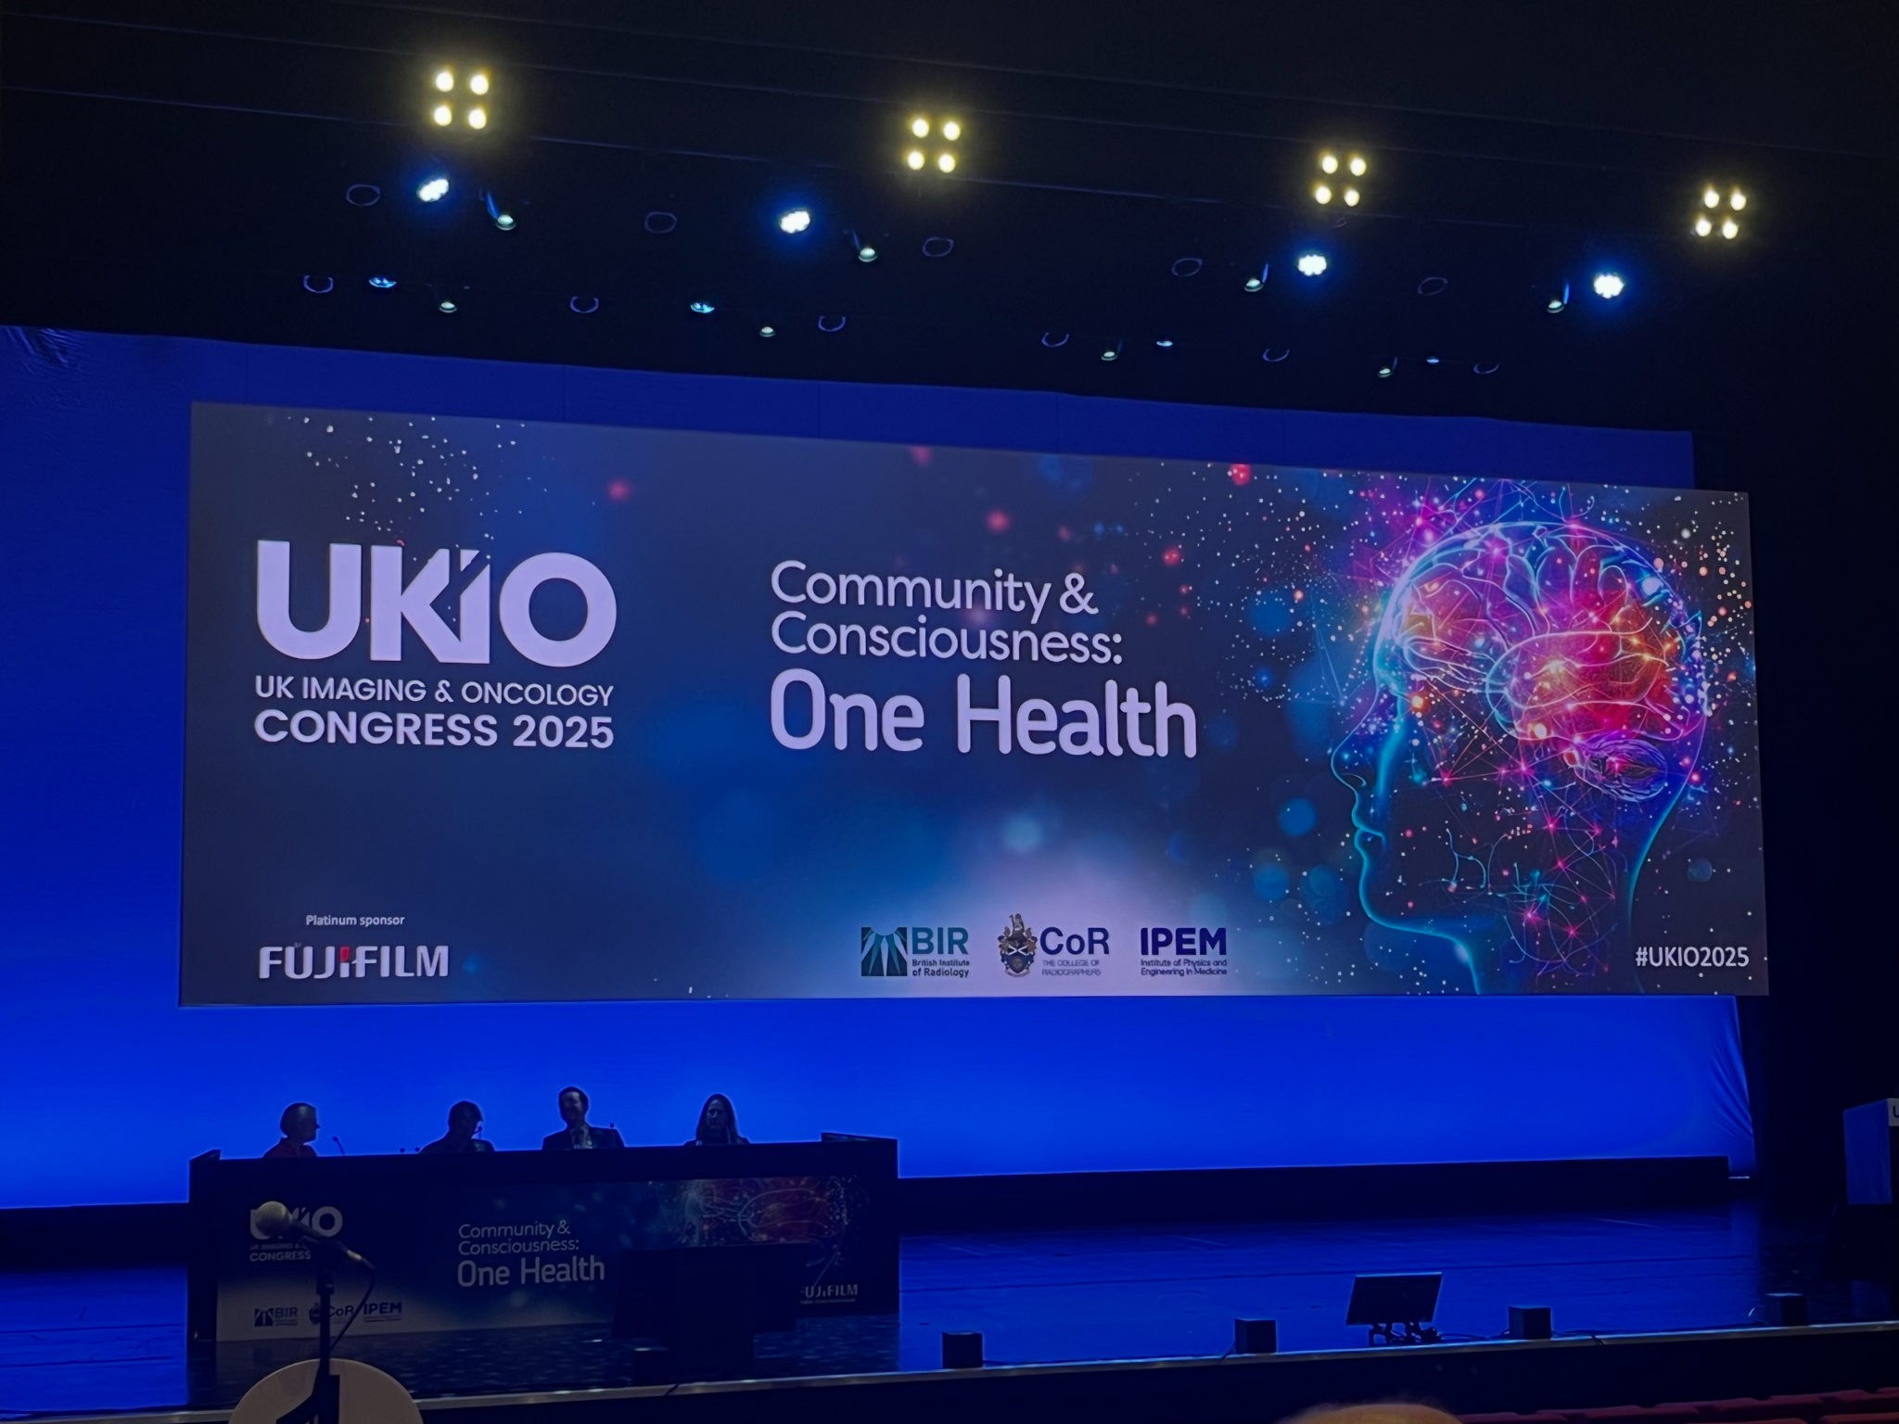
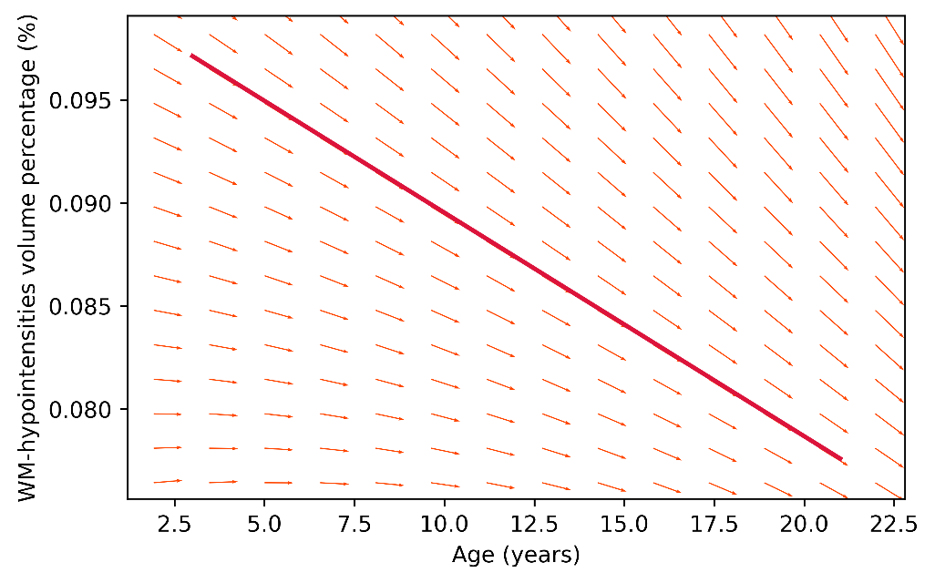
Iolyn Chennell MPhys (Hons) Physics
Interests
Science
Cancer Research – Medical Physics
Data Analysis
Programming (Python, C++)

Slide 5
Motivations
UK Household Longitudinal Study (UKHLS)
People with parents who had no qualifications, 18% had a university degree.
People with parents who had a university degree, 64% had a university degree.
46% difference, clear lack of educational mobility.
We want to reduce this disparity as much as possible.

Slide 6
What’s causing this?
Parents who didn’t go to university are less likely to pass on educational habits or know how to support their children’s educational success
Based on their background, students may not believe they are supposed to go to university, convincing themself they won’t belong there
Limited access to tutoring and extracurricular activities
University is financially infeasible for some students
Lack of information about what university is like

Slide 7
Helping A Level Students
Talking about what university Physics will be like for students taking a STEM degree
Examples of undergraduate content
Mock Interviews
Where you can go with Physics (Medical, Space, Engineering, Software, Video Games, Sports Equipment Aerodynamics)

Slide 8
GCSE and Pre-GCSE Students
Removing Physics stigma
Class-wide discussion on how to take a fun, hypothetical measurement
Get groups of students to create their own measurements and talking about how they can be improved
Possibly some group tutoring for maths and physics homework

Slide 9
The Goals
We want to see enrollment in STEM based GCSE’s increase and A Level students more certain of the decision they make before university.
Increase positive opinion of STEM subjects and get students to connect their interests to them.

